Slide 1
Triplet Embeddings for Demand Estimation
Originally by Magnolfi, McClure, and Sorensen in 2022
Presented by Gideon Moore
Spring 2024

Slide 2
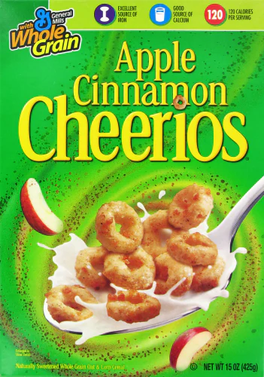
What’s in a Product?
Apple Cinnamon Cheerios have many characteristics:
Part of the “Cheerios” line
Fruit flavored
12 grams of sugar per serving
10 servings per box
A General Mills product
CS value of $66.8 million per annum
Headache for demand estimation:
Which characteristics matter?
What can we do if characteristic data aren’t clean?

Slide 3

Why Estimate Demand?
Informs counterfactual hypotheticals
What if I enter a new market?
How will firms react under new regulation?
If demand for one type of good shifts, which firms benefit and by how much?

Slide 4
Previous Solutions
Product-Level Analysis: ignore characteristics completely
Good for markets of existing products
Near-useless for products entering the market
Kitchen Sink Approaches: see what sticks
Data-hungry regularization process
Requires encoding hundreds of characteristics
Most get thrown out
Still may not be exhaustive!
Introspection: what feels right
Heavily subjective—what matters to Pakes may not matter to me
Likely to miss something important

Slide 5

You Know It When You See It
From the Instacart Website:
Items may be out of stock. When this happens, you have 3 options—
Find Best Match: Your shopper selects the best possible replacement. This is the default option for when items aren’t available…

Slide 6
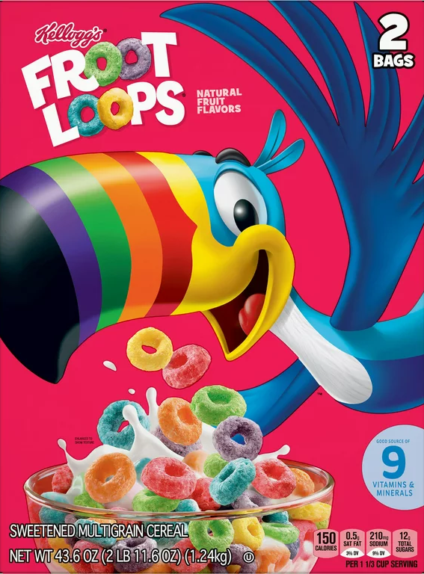

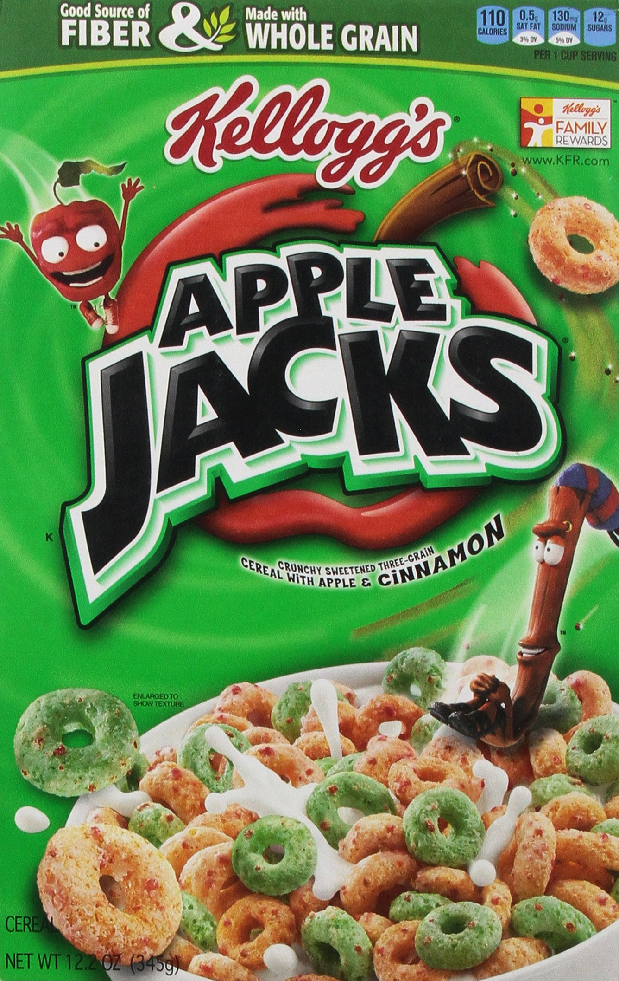

You Know It When You See It

Slide 7
The Goal
The above “sounds nice”—people have an intuitive grasp of which products are substitutes. Can we formalize this into something econometrically useful?
Want to use ordinal comparisons to predict substitution patterns
Can do so by converting these comparisons into cardinal embeddings
Desiderata relative to existing methods:
Flexible substitution patterns with useful out-of-sample predictions
Minimal data demands
Independence from investigator judgment
If this is feasible, unlocks demand estimation in markets and products with “hard to define” characteristics
What college majors do people choose?
How do people vote when candidates enter or drop out?
Which jobs do people apply for after a layoff?
What metro areas do people move to?

Slide 8
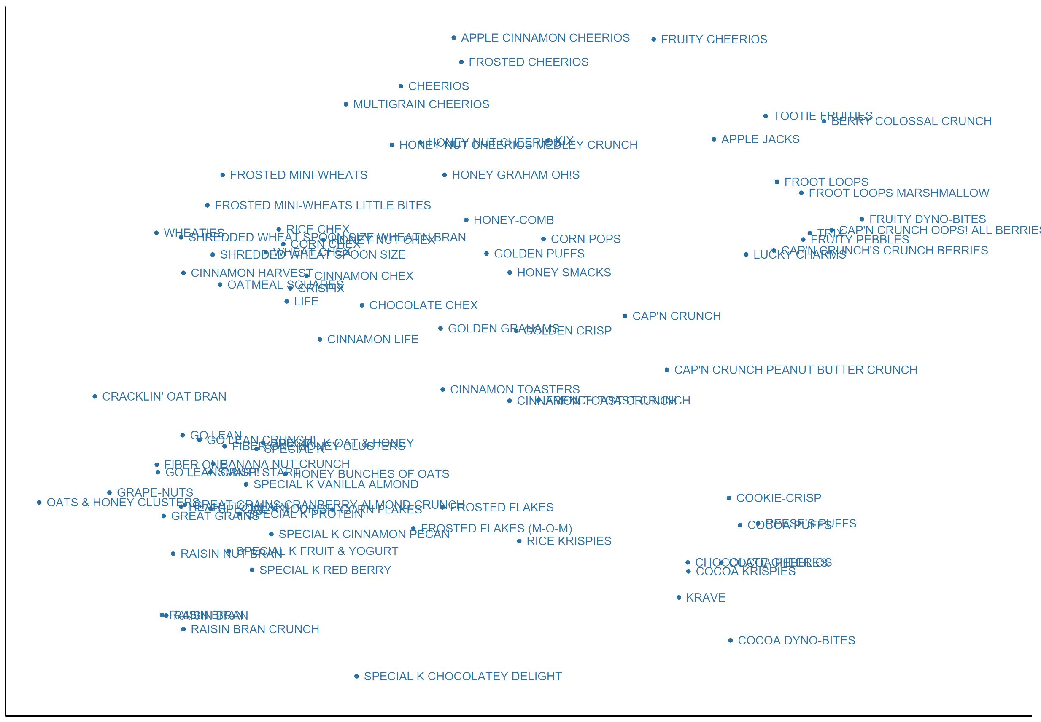
Results Preview
This is something of a “magic trick” paper
Generates compelling cardinal characteristics from ordinal data alone
Under heavy data constraints, embedding-based substitution patterns better fit standard priors than patterns derived from interpretable characteristics
Minimal(-ish) structural assumptions
Shredded Wheat
Fruity
Chocolate

Slide 9
From Triplets to Embeddings

Slide 10

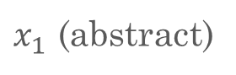
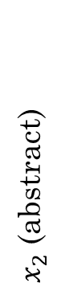
What is an Embedding?
Suppose we start with a set of objects:
{King, Queen, Doe, Stag}
We understand the structure within this data, but would like to represent it numerically
Geometrically:
$x_{2}$ (abstract)
Queen
Verbally:
“King is to Queen as Stag is to Doe”
King
Formally:
King : Queen :: Stag : Doe
Doe
Mathematically:
King – Queen = Stag – Doe
Stag
$x_{1}$ (abstract)

Slide 11
Direction and Magnitude
We care about more than just direction—would like to have some interpretation of magnitude
Geometrically:
$x_{2}$ (abstract)
Dog
Verbally:
“The difference between a dog and a wolf is less than the difference between a dog and a fish”
Wolf
Mathematically:
|dog – wolf| < |dog – fish|
Fish
$x_{1}$ (abstract)

Slide 12
Embedding with Triplets: The Intuition
We are told “Diamond is Closer to Circle than to Pentagon”
Thus, the center embedding cannot be correct
Next, we get “Circle is Closer to Diamond than to Pentagon”
Thus, the right embedding cannot be correct

Slide 13
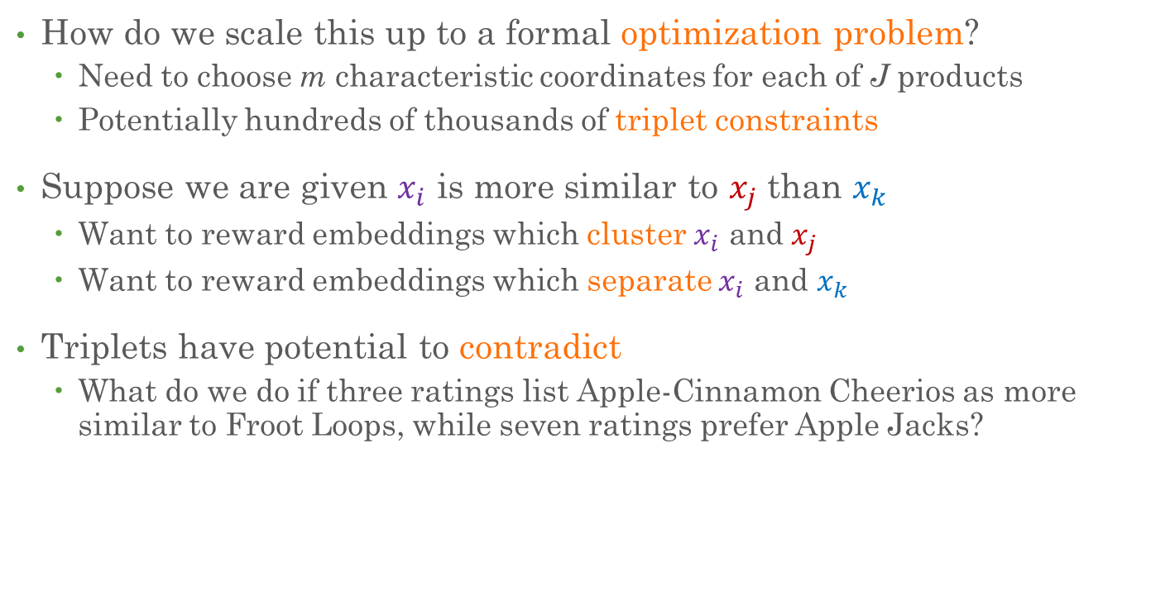
From Triplets to Embeddings
How do we scale this up to a formal optimization problem?
Need to choose m characteristic coordinates for each of J products
Potentially hundreds of thousands of triplet constraints
Suppose we are given $x_{i}$ is more similar to $x_{j}$ than $x_{k}$
Want to reward embeddings which cluster $x_{i}$ and $x_{j}$
Want to reward embeddings which separate $x_{i}$ and $x_{k}$
Triplets have potential to contradict
What do we do if three ratings list Apple-Cinnamon Cheerios as more similar to Froot Loops, while seven ratings prefer Apple Jacks?

Slide 14

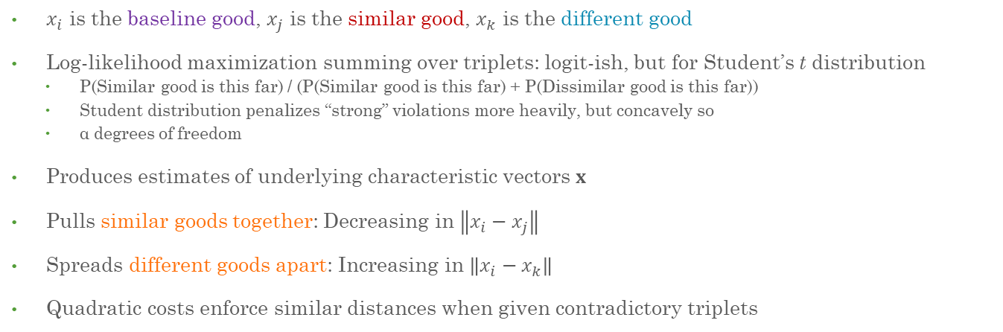
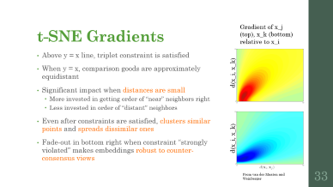

T-Distributed Stochastic Triplet Embedding
$$\max_{x}{\sum_{(i,j,k)∈T}{ln⁡\left(\frac{{\left(1+\frac{{\left\|x_{i}−x_{j}\right\|}^{2}}{α}\right)}^{−\frac{α+1}{2}}}{{\left(1+\frac{{\left\|x_{i}−x_{j}\right\|}^{2}}{α}\right)}^{−\frac{α+1}{2}}+{\left(1+\frac{{\left\|x_{i}−x_{k}\right\|}^{2}}{α}\right)}^{−\frac{α+1}{2}}}\right)}}$$
$x_{i}$ is the baseline good, $x_{j}$ is the similar good, $x_{k}$ is the different good
Log-likelihood maximization summing over triplets: logit-ish, but for Student’s t distribution
P(Similar good is this far) / (P(Similar good is this far) + P(Dissimilar good is this far))
Student distribution penalizes “strong” violations more heavily, but concavely so
α degrees of freedom
Produces estimates of underlying characteristic vectors $x$
Pulls similar goods together: Decreasing in $\left\|x_{i}−x_{j}\right\|$
Spreads different goods apart: Increasing in $\left\|x_{i}−x_{k}\right\|$
Quadratic costs enforce similar distances when given contradictory triplets

Slide 15
Model & Application

Slide 16
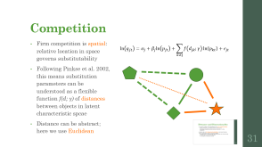
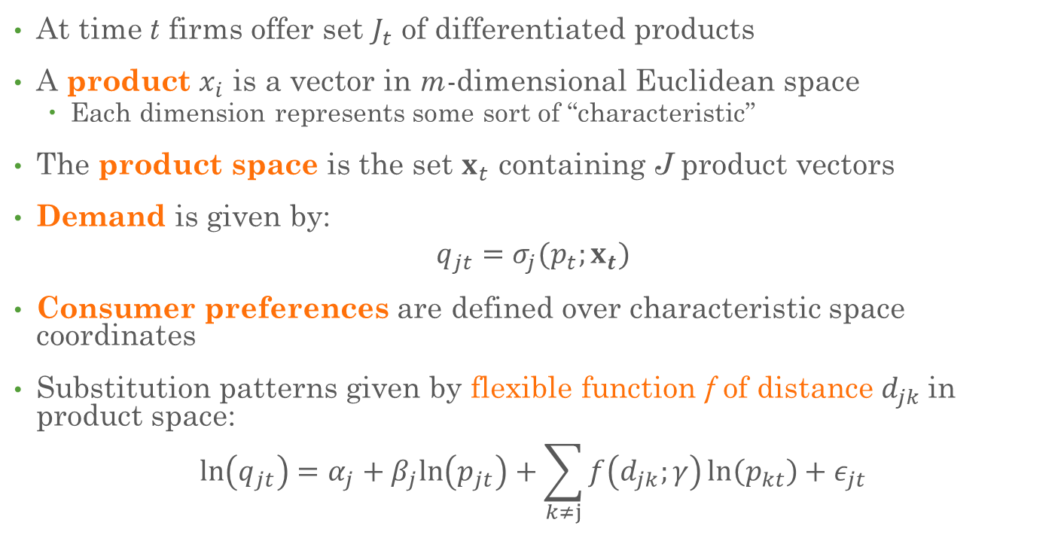
The Model
At time t firms offer set $J_{t}$ of differentiated products
A product $x_{i}$ is a vector in m-dimensional Euclidean space
Each dimension represents some sort of “characteristic”
The product space is the set $x_{t}$ containing J product vectors
Demand is given by:
$$q_{jt}=σ_{j}(p_{t};x_{t})$$
Consumer preferences are defined over characteristic space coordinates
Substitution patterns given by flexible function f of distance $d_{jk}$in product space:
$$\ln\left(q_{jt}\right)=α_{j}+β_{j}ln\left(p_{jt}\right)+\sum_{k≠j}{f\left(d_{jk};γ\right)\ln\left(p_{kt}\right)}+ε_{jt}$$

Slide 17
Setting
Price and quantity data from Nielsen
Study substitution patterns in ready-to-eat breakfast cereal
UPC-store-week level
86 brands accounting for >80% of cereal sales

Slide 18
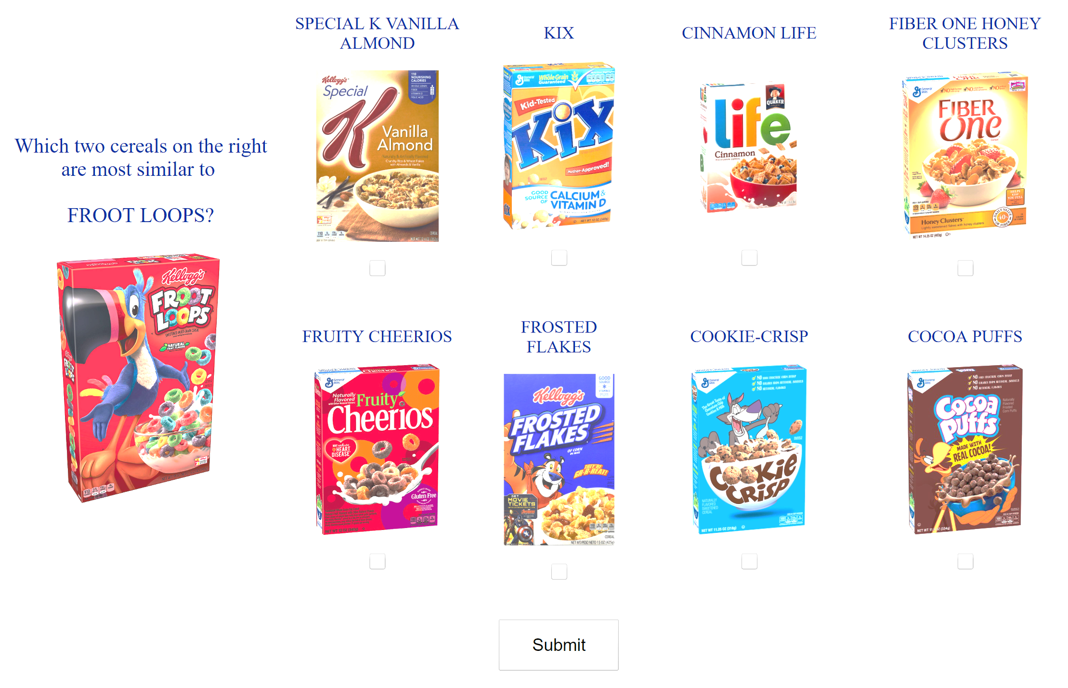


Scaling It Up
 | Fruity Cheerios | Frosted Flakes
Special K | (FC, SK, FL) | (FF, SK, FL)
Kix | (FC, KX, FL) | (FF, KX, FL)
Life | (FC, LF, FL) | (FF, LF, FL)
Fiber One | (FC, FO, FL) | (FF, FO, FL)
Cookie Crisp | (FC, CC, FL) | (FF, CC, FL)
Cocoa Puffs | (FC, CP, FL) | (FF, CP, FL)
Authors gave Wisconsin undergrads and Amazon M-Turk workers the above survey
Every (selected, not selected) pair produces a triplet
Each response provides 2 x 6 =12 triplets
Final sample includes 12 x 8,985 = 107,820 triplets

Slide 19
Clustering Results

Slide 20
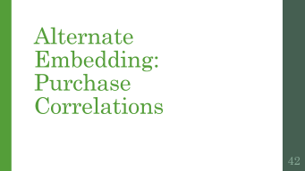
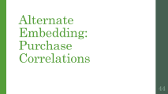
Two-Dimensional Embedding Plot
Shredded Wheat
Fruity
Chocolate
t-STE produces meaningful clusters in two dimensions

Slide 21
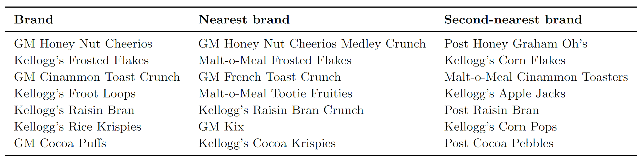
Six-Dimensional Nearest Neighbors
Two nearest neighbors using six-dimensional Euclidean distance
Highlighted brands are highest revenue products

Slide 22
Log-Linear Demand Model

Slide 23
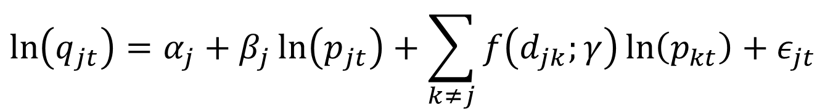
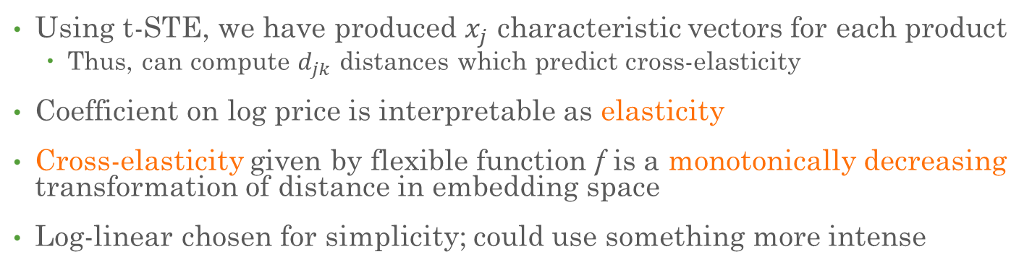
Log-Linear Demand Model
$$\ln\left(q_{jt}\right)=α_{j}+β_{j}\ln\left(p_{jt}\right)+\sum_{k≠j}{f\left(d_{jk};γ\right)\ln\left(p_{kt}\right)+ε_{jt}}$$
Using t-STE, we have produced $x_{j}$ characteristic vectors for each product
Thus, can compute $d_{jk}$ distances which predict cross-elasticity
Coefficient on log price is interpretable as elasticity
Cross-elasticity given by flexible function f is a monotonically decreasing transformation of distance in embedding space
Log-linear chosen for simplicity; could use something more intense

Slide 24
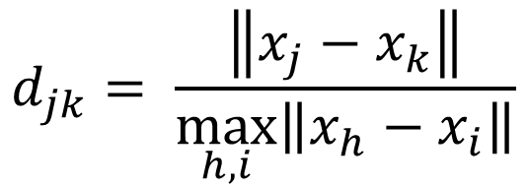


Functional Form
Authors test flexible approaches
Sieves
B-Splines
Prefer a normalized cubic polynomial:
$$f\left(d_{jk};γ\right)=γ_{0}+γ_{1}d_{jk}+γ_{2}d_{jk}^{2}+γ_{3}d_{jk}^{3}$$
$$d_{jk}= \frac{\left\|x_{j}−x_{k}\right\|}{\max_{h, i}\left\|x_{h}−x_{i}\right\|}$$

Slide 25
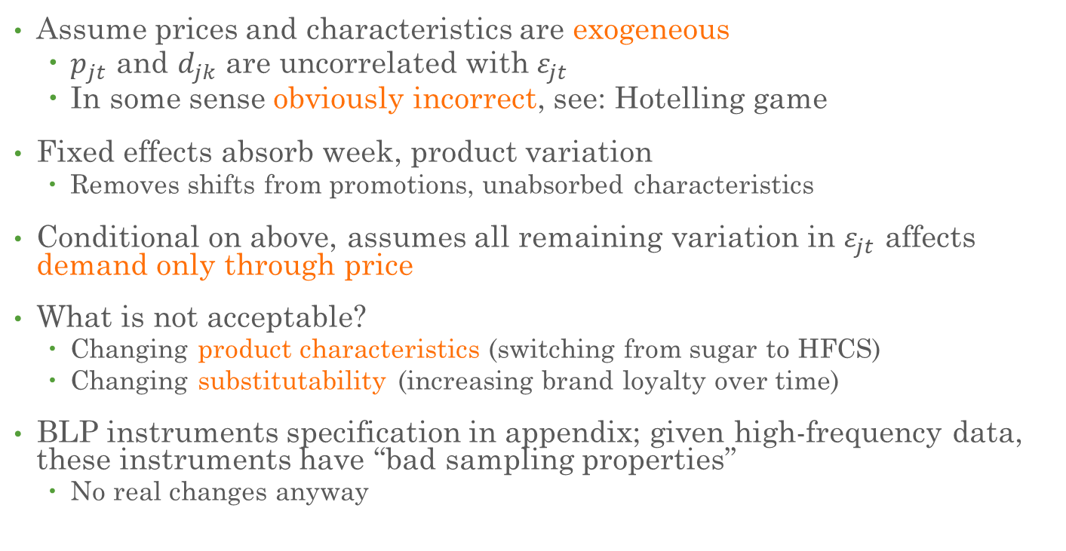
Identification
Assume prices and characteristics are exogeneous
$p_{jt}$ and $d_{jk}$ are uncorrelated with $ε_{jt}$
In some sense obviously incorrect, see: Hotelling game
Fixed effects absorb week, product variation
Removes shifts from promotions, unabsorbed characteristics
Conditional on above, assumes all remaining variation in $ε_{jt}$ affects demand only through price
What is not acceptable?
Changing product characteristics (switching from sugar to HFCS)
Changing substitutability (increasing brand loyalty over time)
BLP instruments specification in appendix; given high-frequency data, these instruments have “bad sampling properties”
No real changes anyway

Slide 26
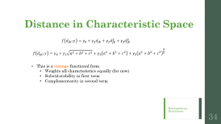

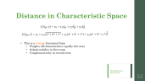

Benchmark
$$f\left(d_{jk};γ\right)=γ_{0}+γ_{1}d_{jk}+γ_{2}d_{jk}^{2}+γ_{3}d_{jk}^{3}+γ_{4}1(G_{j}≠G_{k})$$
Compare specification with only normalized observable characteristics
Sugar
Fiber
Calories from fat
Converts above to distance measure rather than regressing directly
Also adds dummy for target audience (Kids, Adult, All Family)
Cross-group elasticities just transformed by a constant (weird)
Somewhat odd, but ensures benchmark has same degrees of freedom—creates an apples-to-apples comparison
Explicitly highlights value of “black box” dimensions relative to interpretable ones
Allows complementarity and substitutability (in a weird way)

Slide 27
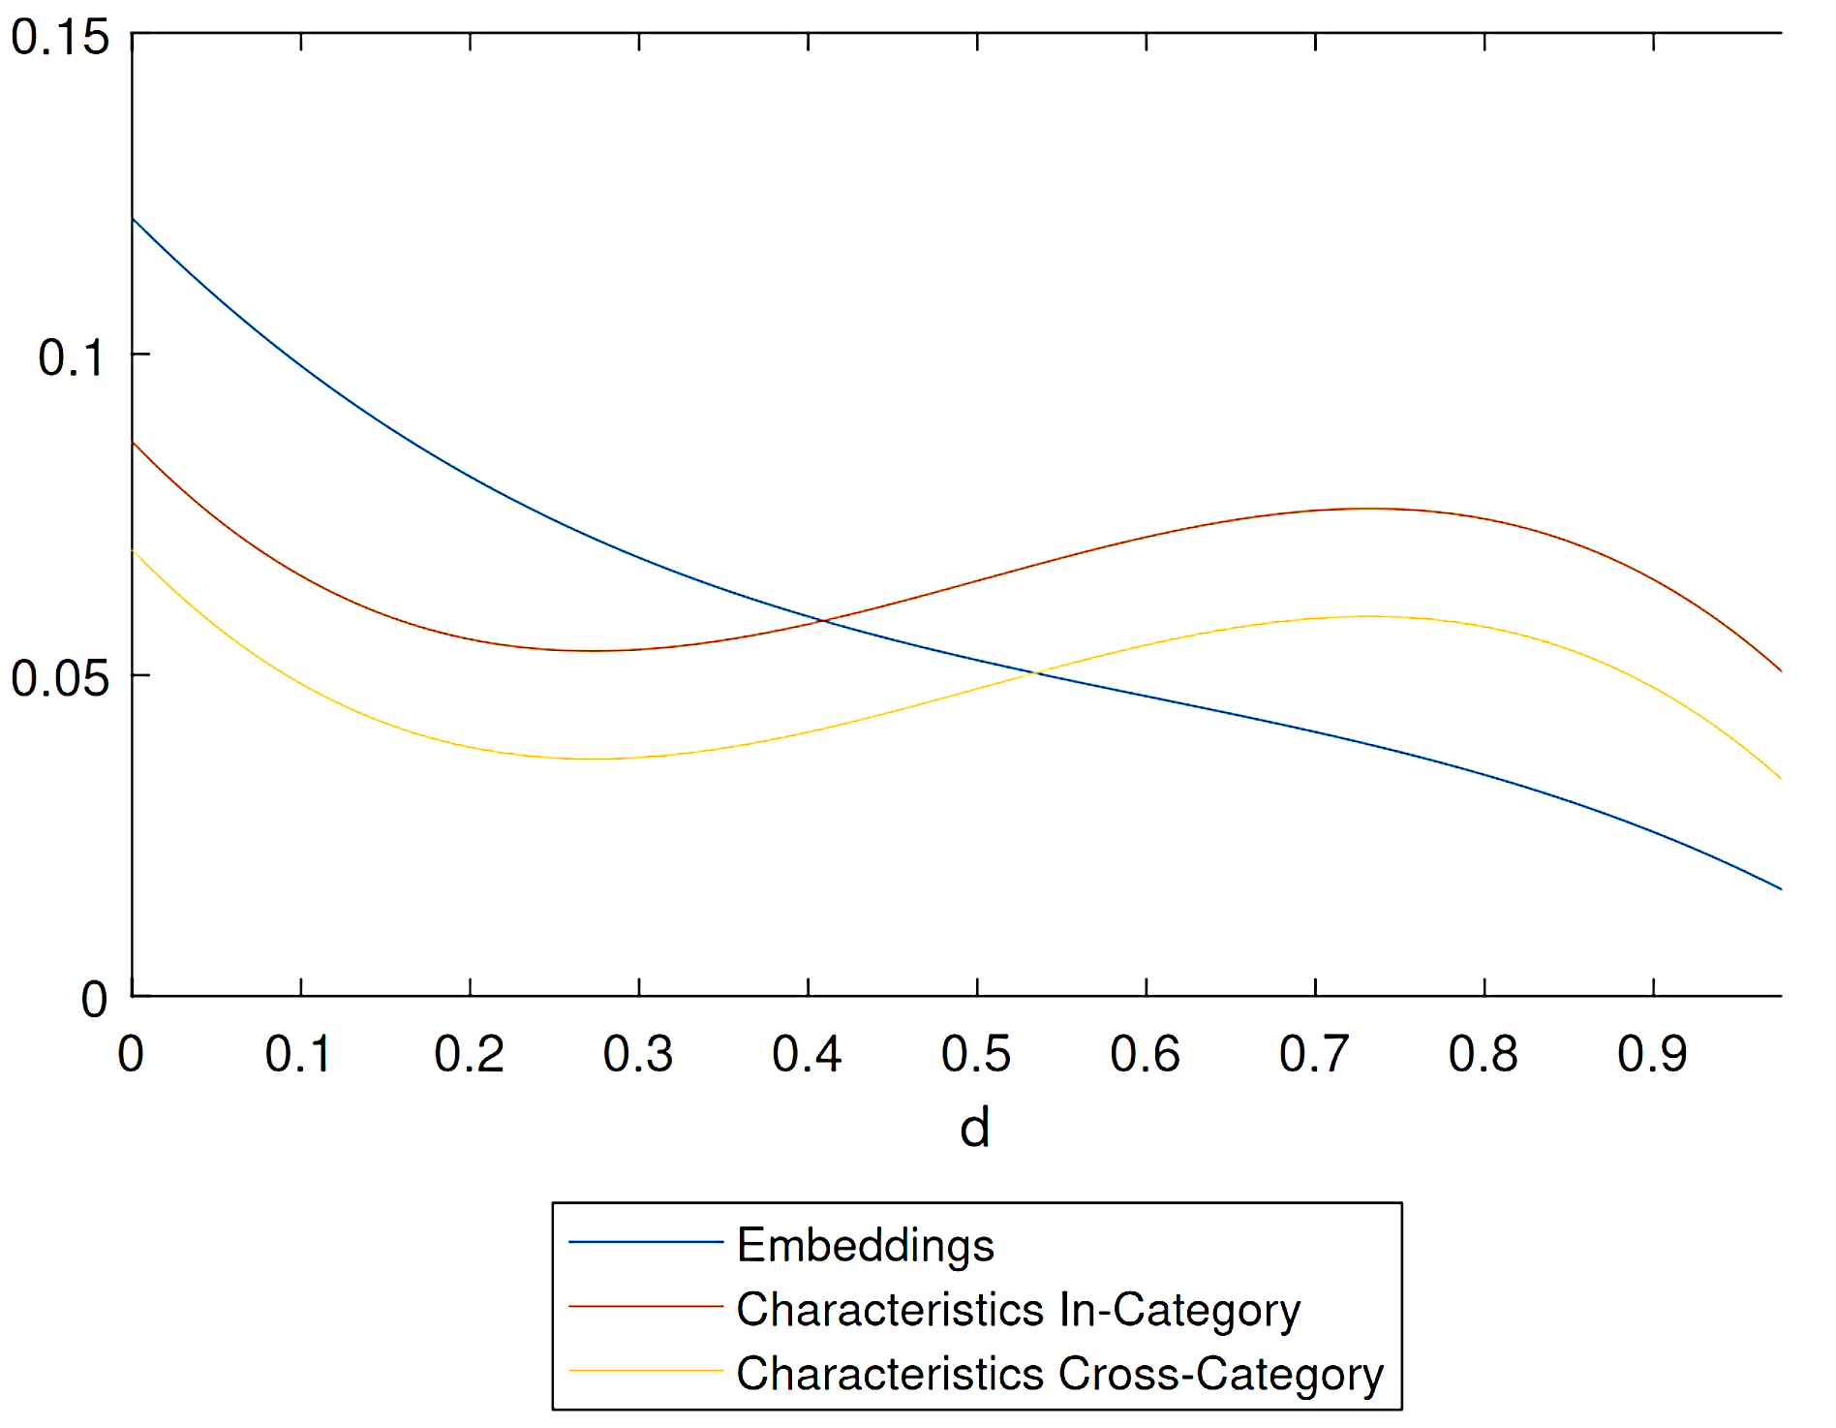


Cross-Elasticities Over Distance
f(d): Cross-Elasticity at d
Only for the triplet embedding distance do we get the anticipated monotonically decreasing behavior

Slide 28
Conclusion

Slide 29

Efficacy of Embedding Models
Embedding-based models get better substitution patterns than traditional characteristic-based approaches, which predict non-monotonic substitutability over distance
Triplet embeddings are easy to understand and cheap to collect
Require little structured data and little researcher judgement
Results robust to other embedding methods
f(d): Cross-Elasticity at d

Slide 30
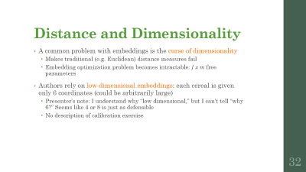





Appendix

Slide 31

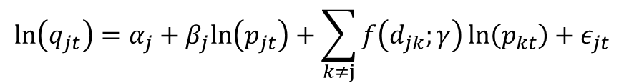
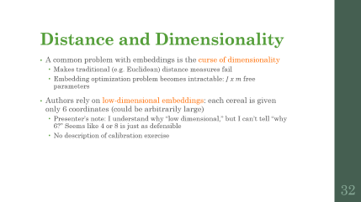
Competition
Firm competition is spatial: relative location in space governs substitutability
Following Pinkse et al. 2002, this means substitution parameters can be understood as a flexible function f(d; γ) of distances between objects in latent characteristic spcae
Distance can be abstract; here we use Euclidean
$$\ln\left(q_{jt}\right)=α_{j}+β_{j}ln\left(p_{jt}\right)+\sum_{k≠j}{f\left(d_{jk};γ\right)\ln\left(p_{kt}\right)}+ε_{jt}$$

Slide 32
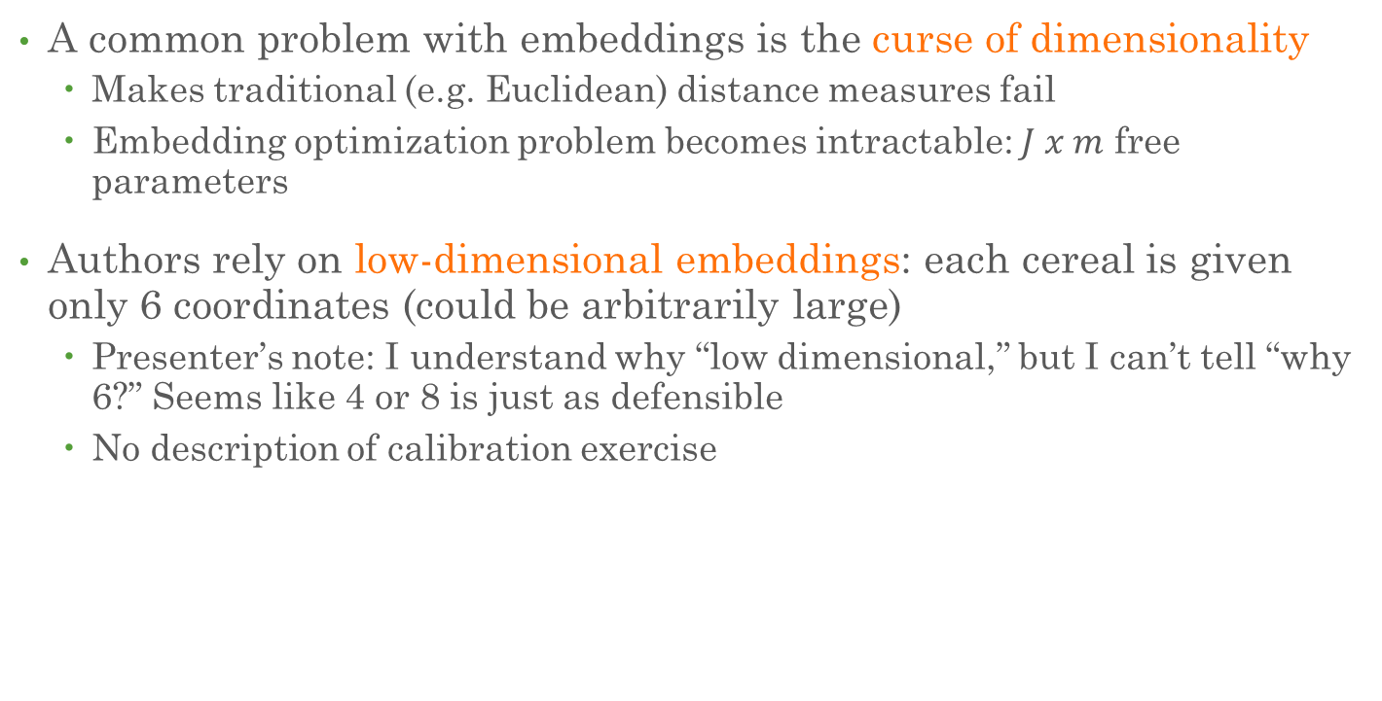
Distance and Dimensionality
A common problem with embeddings is the curse of dimensionality
Makes traditional (e.g. Euclidean) distance measures fail
Embedding optimization problem becomes intractable: $J x m$ free parameters
Authors rely on low-dimensional embeddings: each cereal is given only 6 coordinates (could be arbitrarily large)
Presenter’s note: I understand why “low dimensional,” but I can’t tell “why 6?” Seems like 4 or 8 is just as defensible
No description of calibration exercise

Slide 33
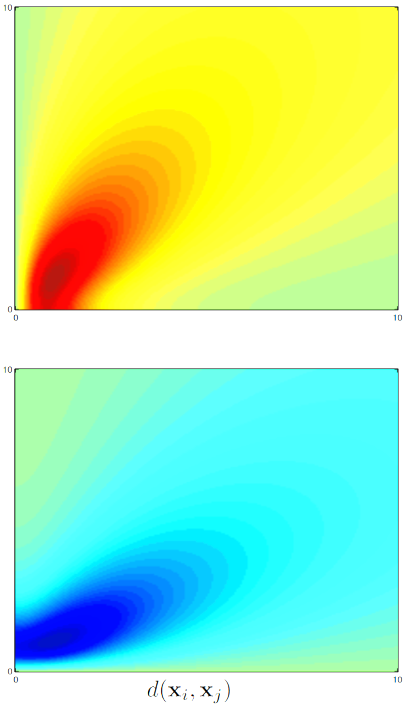
t-SNE Gradients
Gradient of x_j (top), x_k (bottom) relative to x_i
Above y = x line, triplet constraint is satisfied
When y = x, comparison goods are approximately equidistant
Significant impact when distances are small
More invested in getting order of “near” neighbors right
Less invested in order of “distant” neighbors
Even after constraints are satisfied, clusters similar points and spreads dissimilar ones
Fade-out in bottom right when constraint “strongly violated” makes embeddings robust to counter-consensus views
d(x_i, x_k)
d(x_i, x_k)
From van der Maaten and Weinberger

Slide 34
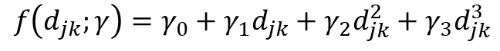

Distance in Characteristic Space
$$f\left(d_{jk};γ\right)=γ_{0}+γ_{1}d_{jk}+γ_{2}d_{jk}^{2}+γ_{3}d_{jk}^{3}$$
$$f\left(d_{jk};γ\right)=γ_{0}+γ_{1}\sqrt{a^{2}+b^{2}+c^{2}}+γ_{2}\left(a^{2}+b^{2}+c^{2}\right)+γ_{3}{\left(a^{2}+b^{2}+c^{2}\right)}^{\frac{3}{2}}$$
This is a strange functional form
Weights all characteristics equally (for now)
Substitutability in first term
Complementarity in second term

Slide 35
Heterogeneous Dimensions

Slide 36
Dimension Heterogeneity
Thus far, we have treated dimensions homogeneously
Reasonable in some settings like spatial competition
However, no reason to believe this is true: different dimensions may have heterogeneous impacts on substitution
E.G. I care about whether my cereal has chocolate, but fiber content is less important

Slide 37
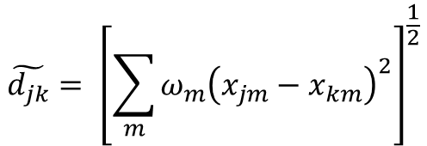
Dimension Weighting
Rather than using Euclidean distance as before, we can weight each dimension differently as follows:
$$\tilde{d_{jk}}= {\left[\sum_{m}{ω_{m}{\left(x_{jm}−x_{km}\right)}^{2}}\right]}^{\frac{1}{2}}$$
Normalizing weight of the first dimension to 1, the above is estimable using nonlinear least squares within our cubic distance function

Slide 38
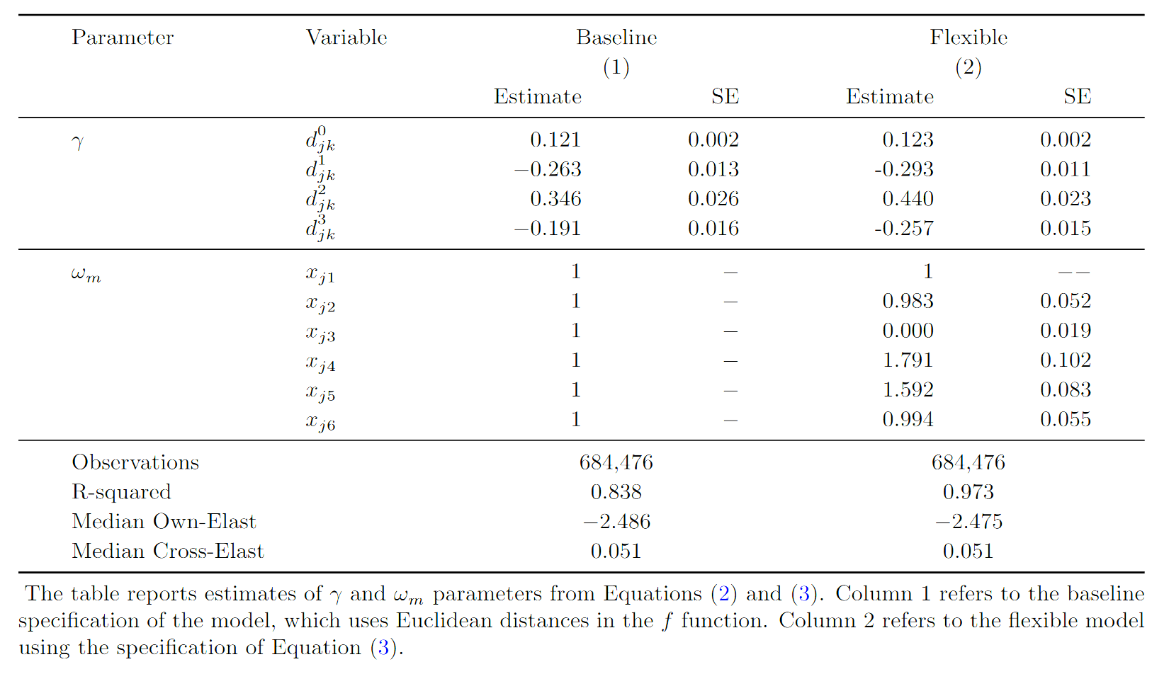
Homogeneous vs. Heterogeneous Weight Results
Significant heterogeneity in dimension importance
Elasticities very similar, but model fit (obviously?) improves drastically

Slide 39
Random Coefficient (BLP) Demand Model

Slide 40
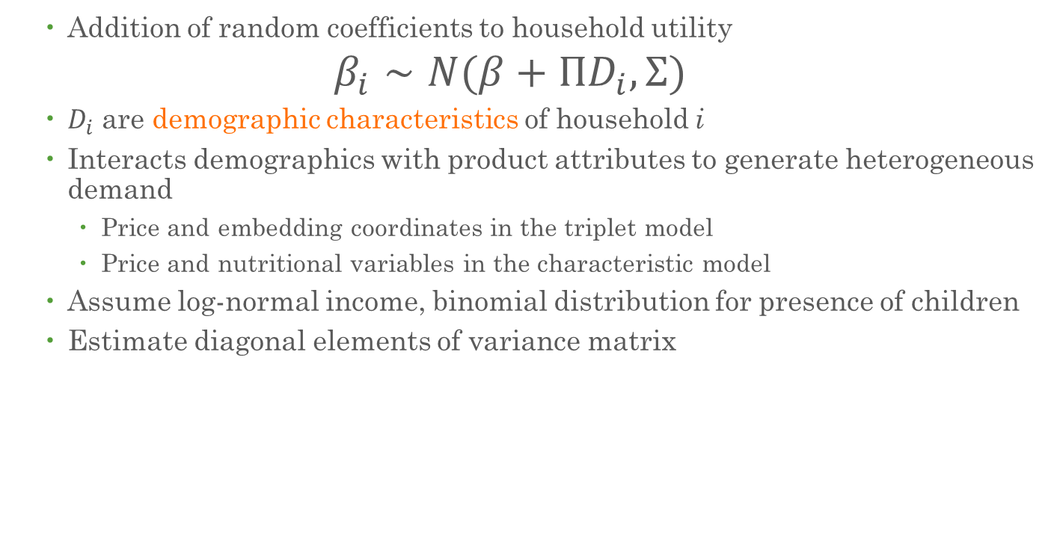
Random Coefficient Demand Model
Addition of random coefficients to household utility
$$β_{i}∼N(β+ΠD_{i}, Σ)$$
$D_{i}$ are demographic characteristics of household i
Interacts demographics with product attributes to generate heterogeneous demand
Price and embedding coordinates in the triplet model
Price and nutritional variables in the characteristic model
Assume log-normal income, binomial distribution for presence of children
Estimate diagonal elements of variance matrix

Slide 41
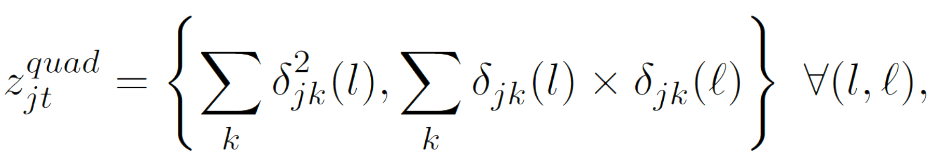
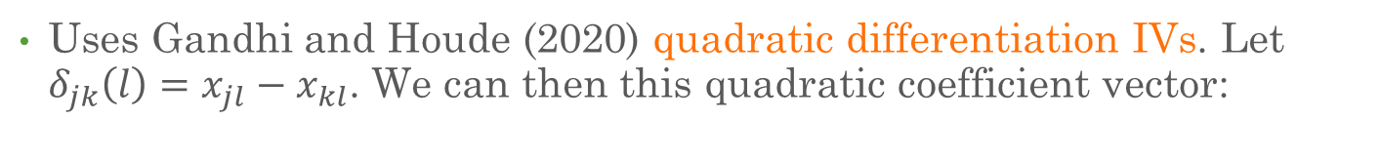
Identification
Uses Gandhi and Houde (2020) quadratic differentiation IVs. Let $δ_{jk}\left(l\right)=x_{jl}−x_{kl}$. We can then this quadratic coefficient vector:
The authors then interact this vector of coefficients with the 10th, 50th, and 90th percentiles of income and the percentage of households with children to form the final 168 instruments
Model is then estimated using 2-step GMM

Slide 42
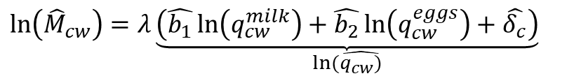
Market Size
Market size is number of people entering the grocery store
Assumes no one induced to enter store by change in cereal price
Estimated using variation in purchases of milk and eggs
$$\ln\left(q_{cw}\right)=b_{1}\ln\left(q_{cw}^{milk}\right)+b_{2}\ln\left(q_{cw}^{eggs}\right)+δ_{c}+ε_{cw}$$
Under this specification, we can then estimate the total market size:
$$\ln\left({\hat{M}}_{cw}\right)=λ\underset{ln⁡(\hat{q_{cw})}}{\underbrace{\left(\hat{b_{1}}\ln\left(q_{cw}^{milk}\right)+\hat{b_{2}}\ln\left(q_{cw}^{eggs}\right)+\hat{δ_{c}}\right)}}$$
Authors choose λ such that average outside good share is 0.723 following Backus et al. (2021)

Slide 43
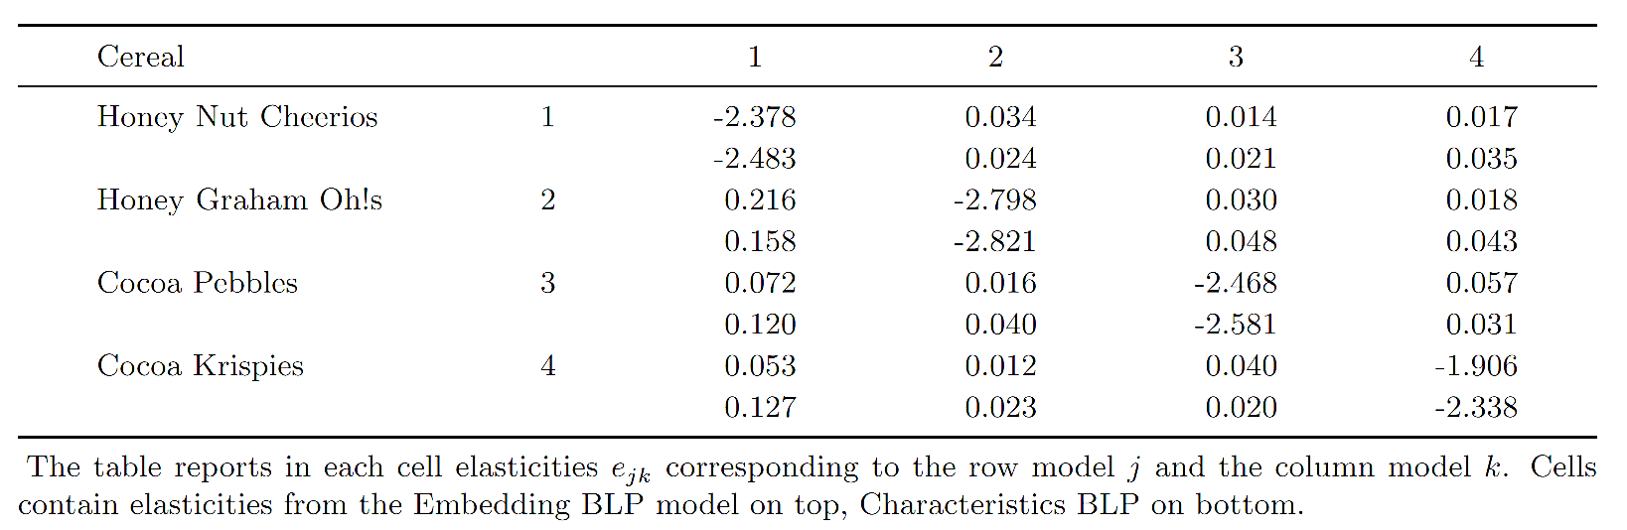
Elasticity Comparison
Own-price elasticities very similar
Similar cereals have higher cross-elasticity
Dissimilar cereals have lower cross-elasticity

Slide 44
Alternate Embedding: Purchase Correlations

Slide 45
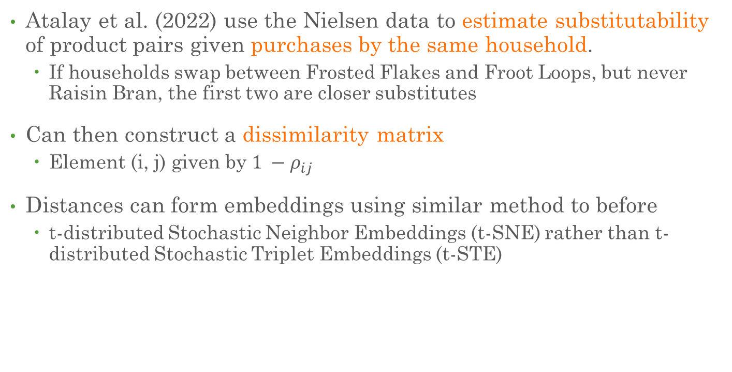
Purchase Correlation Data
Atalay et al. (2022) use the Nielsen data to estimate substitutability of product pairs given purchases by the same household.
If households swap between Frosted Flakes and Froot Loops, but never Raisin Bran, the first two are closer substitutes
Can then construct a dissimilarity matrix
Element (i, j) given by $1 −ρ_{ij}$
Distances can form embeddings using similar method to before
t-distributed Stochastic Neighbor Embeddings (t-SNE) rather than t-distributed Stochastic Triplet Embeddings (t-STE)

Slide 46
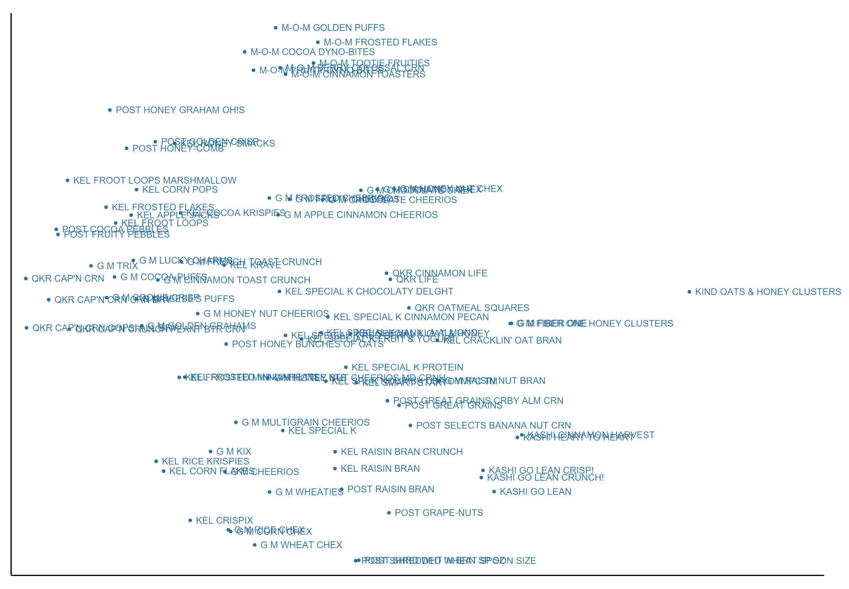
t-SNE Embeddings
As before, embeddings identify meaningful groups
Running analysis using these embeddings yields very similar results—suggests many embeddings are usable

